Slide 1
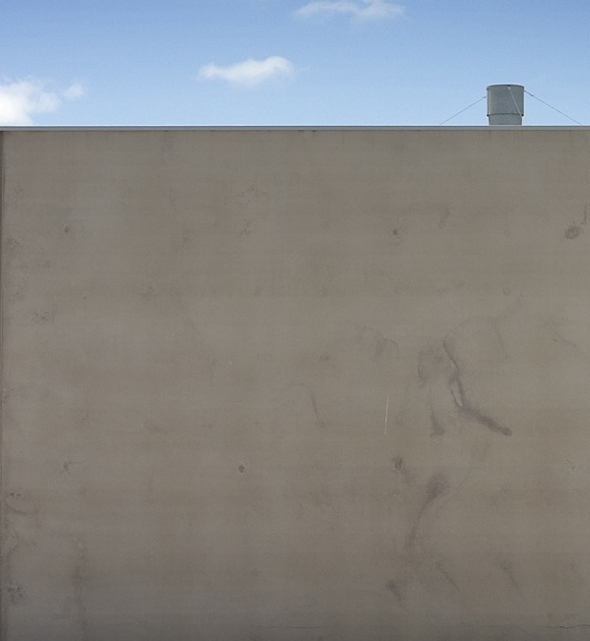



creative block by luke roberts, licensed under a
Creative Commons Attribution Non-Commercial ShareAlike licence 2.0,
http://flickr.com/photos/lukeroberts/292148887/in/pool-ccsalon
state library
14 march 2007
creative commons + open content licensing
state library of queensland copyright advisory committee
copyright information session
elliott bledsoe
project officer
creative commons australia
“some rights reserved”
this presentation is licensed under a Creative Commons Attribution 2.5 Australia licence,
full terms @ http://creativecommons.org/licenses/by/2.5/au/
copyright on other content included in this presentation is noted accordingly
the ccClinic and ccResearch projects are funded by the ARC Centre of Excellence for Creative Industries and Innovation
www.cci.edu.au
Notes:
Hello everyone, I am Elliott Bledsoe and I am a Project Officer with Creative Commons Australia, an Open Content Licensing research project funded by the Australian Research Council Centre of Excellence for Creative Industries and Innovation.

Slide 2
©
Notes:
As librarians and people working in government cultural organisations I am sure you are all aware of copyright

Slide 3
copyright
©
=
all rights reserved
Notes:
Copyright means all rights reserved
that it comes into existence automatically upon creation of a work
no registration is required in order to gain copyright in a work you create
the term of copyright since the Australian-United States Free Trade Agreement is the life of the creator + 70 years

Slide 4

Notes:
When the copyright period lapses works are said to move into the Public Domain.

Slide 5
public domain
=
no rights reserved

Slide 6
©
all rights reserved
no rights reserved

Slide 7

©
some rights reserved
all rights reserved
no rights reserved

Slide 8
creative commons
founded in 2001 by US academics, including Prof Lawrence Lessig
concerned that default copyright laws were restricting creativity in the digital environment
aims to make creative material more freely available through open access licences

Slide 9




creative commons
four licensing protocols:
attribution: requires acknowledgement of the original creator
non-commercial: cannot be reused for commercial purposes
no derivatives: verbatim reuse only
share alike: remix-friendly, but derivative works must be
licenced in the same way
(by)
(nc)
(nd)
(sa)
Notes:
attribution: you let others copy, distribute, display, and perform your copyrighted work but only if they give credit the way you request. This also includes derivative works, meaning this licence can facilitate unfettered remixing.
non-commercial: you let others copy, distribute, display, and perform your copyrighted work but only if they give credit the way you request.
no derivative works: you let others copy, distribute, display, and perform only verbatim copies of your work, not derivative works based upon it.
share alike: you allow others to distribute derivative works only under a license identical to the license that governs your work.
obviously no derivatives and share alike are mutually exclusive.

Slide 10
creative commons
licence options:
by: attribution
by-nc: attribution-noncommerical
by-nd: attribution-noderivs
by-sa: attribution-sharealike
by-nc-nd: attribution-noncommerical-noderivs
by-nc-sa: attribution-noncommerical-sharealike
Notes:
You can combine these protocols.
But if all of this is too much to comprehend, CC has made it easy for people to licence their work.

Slide 11

creative commons
Notes:
Simply go to creativecommons.org.au and click licence your work and you’ll be directed to

Slide 12
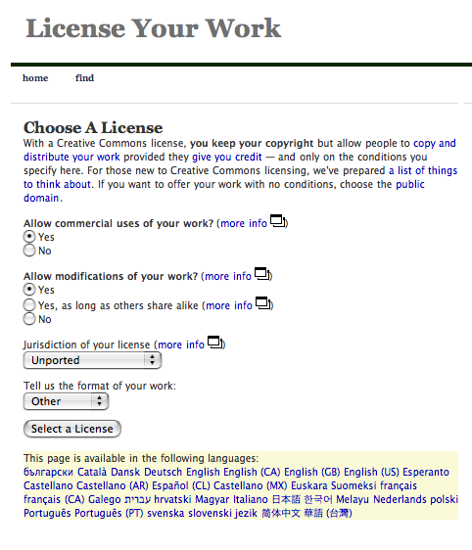
creative commons
Notes:
The licence generator.
Answer the questions, choose your jurisdiction and you are presented with a licence.

Slide 13
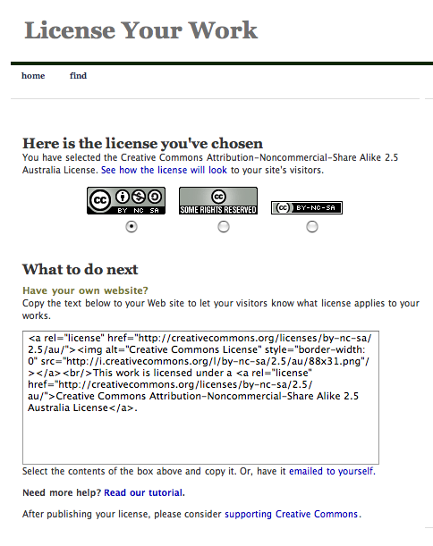
creative commons
Notes:
Here’s one I prepared earlier.
This is an Attribution-ShareAlike Australian licence.

Slide 14
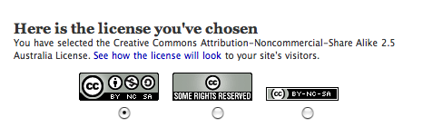
creative commons
Notes:
Within this is a few features.
First decide which licence button you want to use on your work. With the release of the generic 3.0 licences recently came the introduction of two new licence buttons which included the icons for the licence you choose.

Slide 15
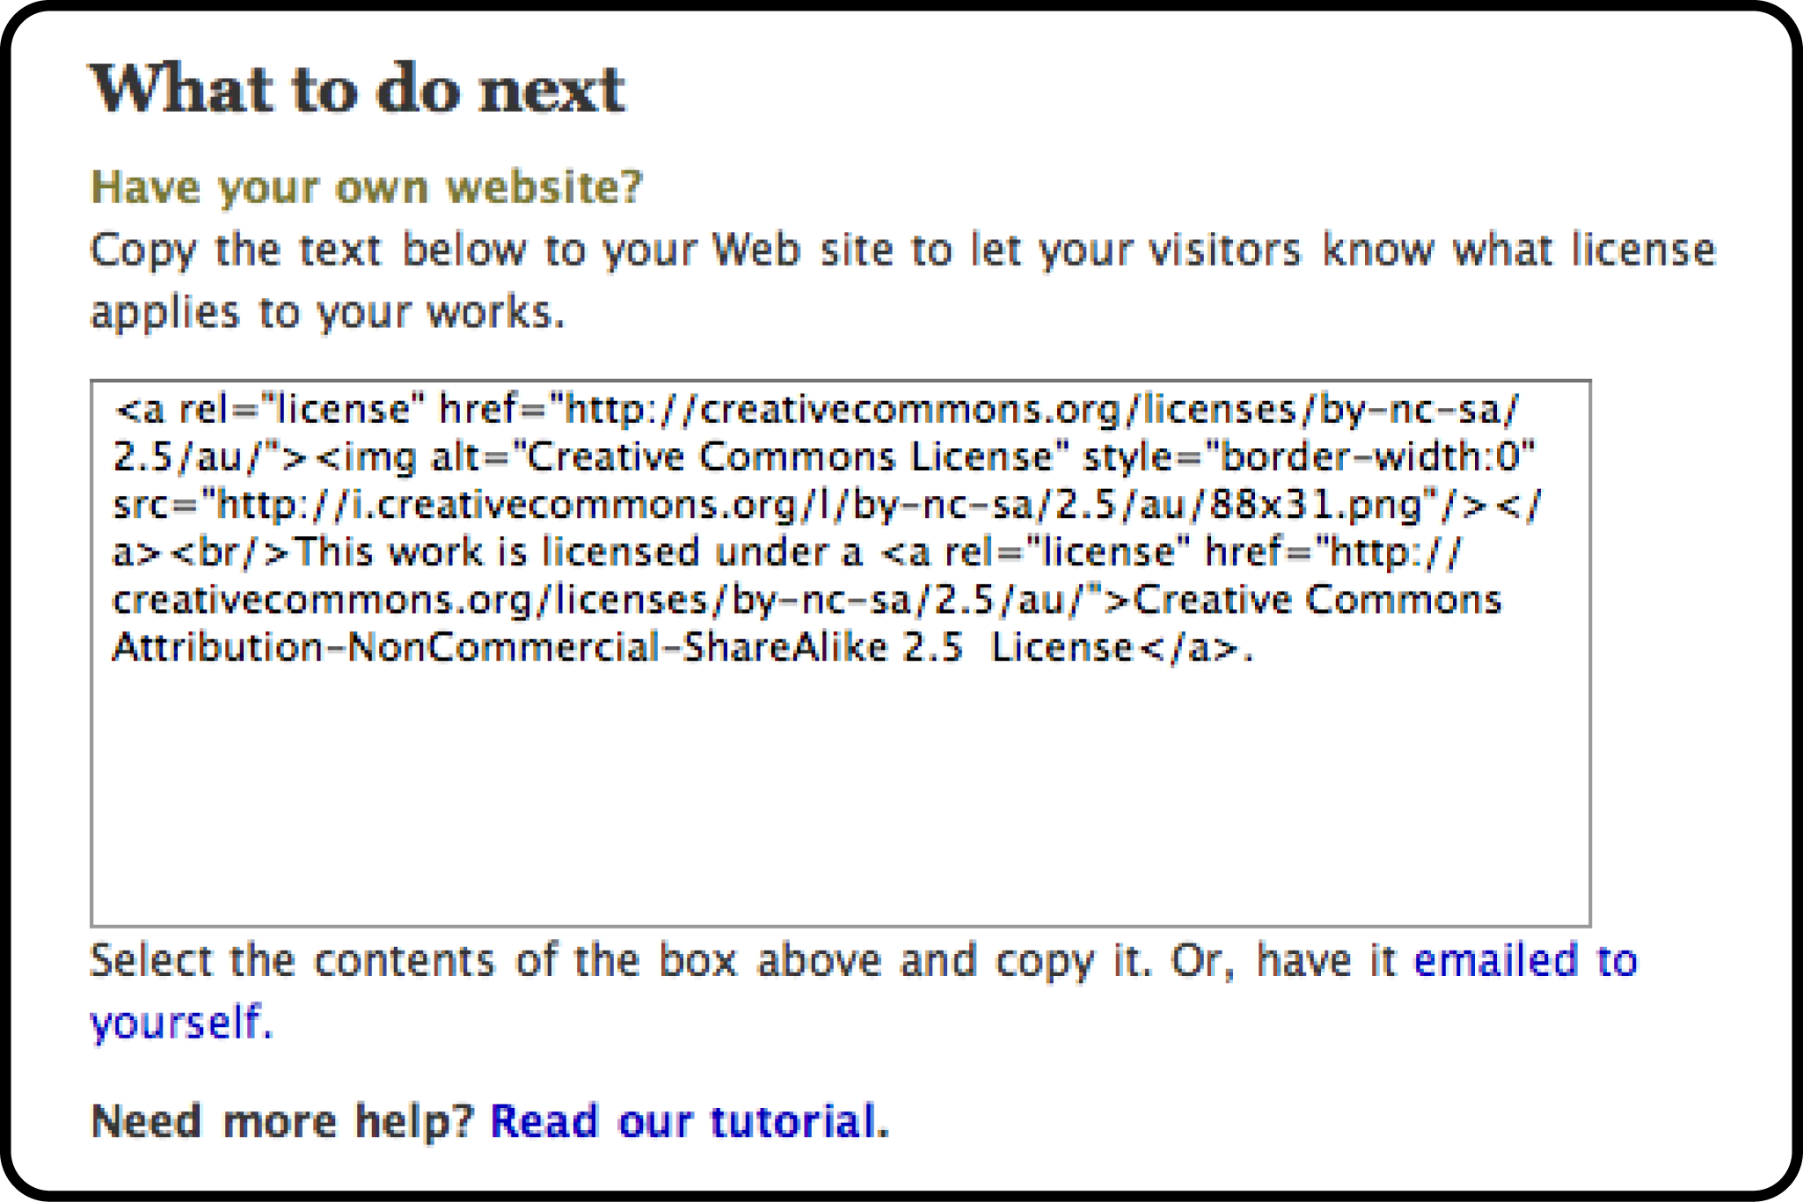
creative commons
Notes:
Below that is the metadata or technical code for your licence.

Slide 16
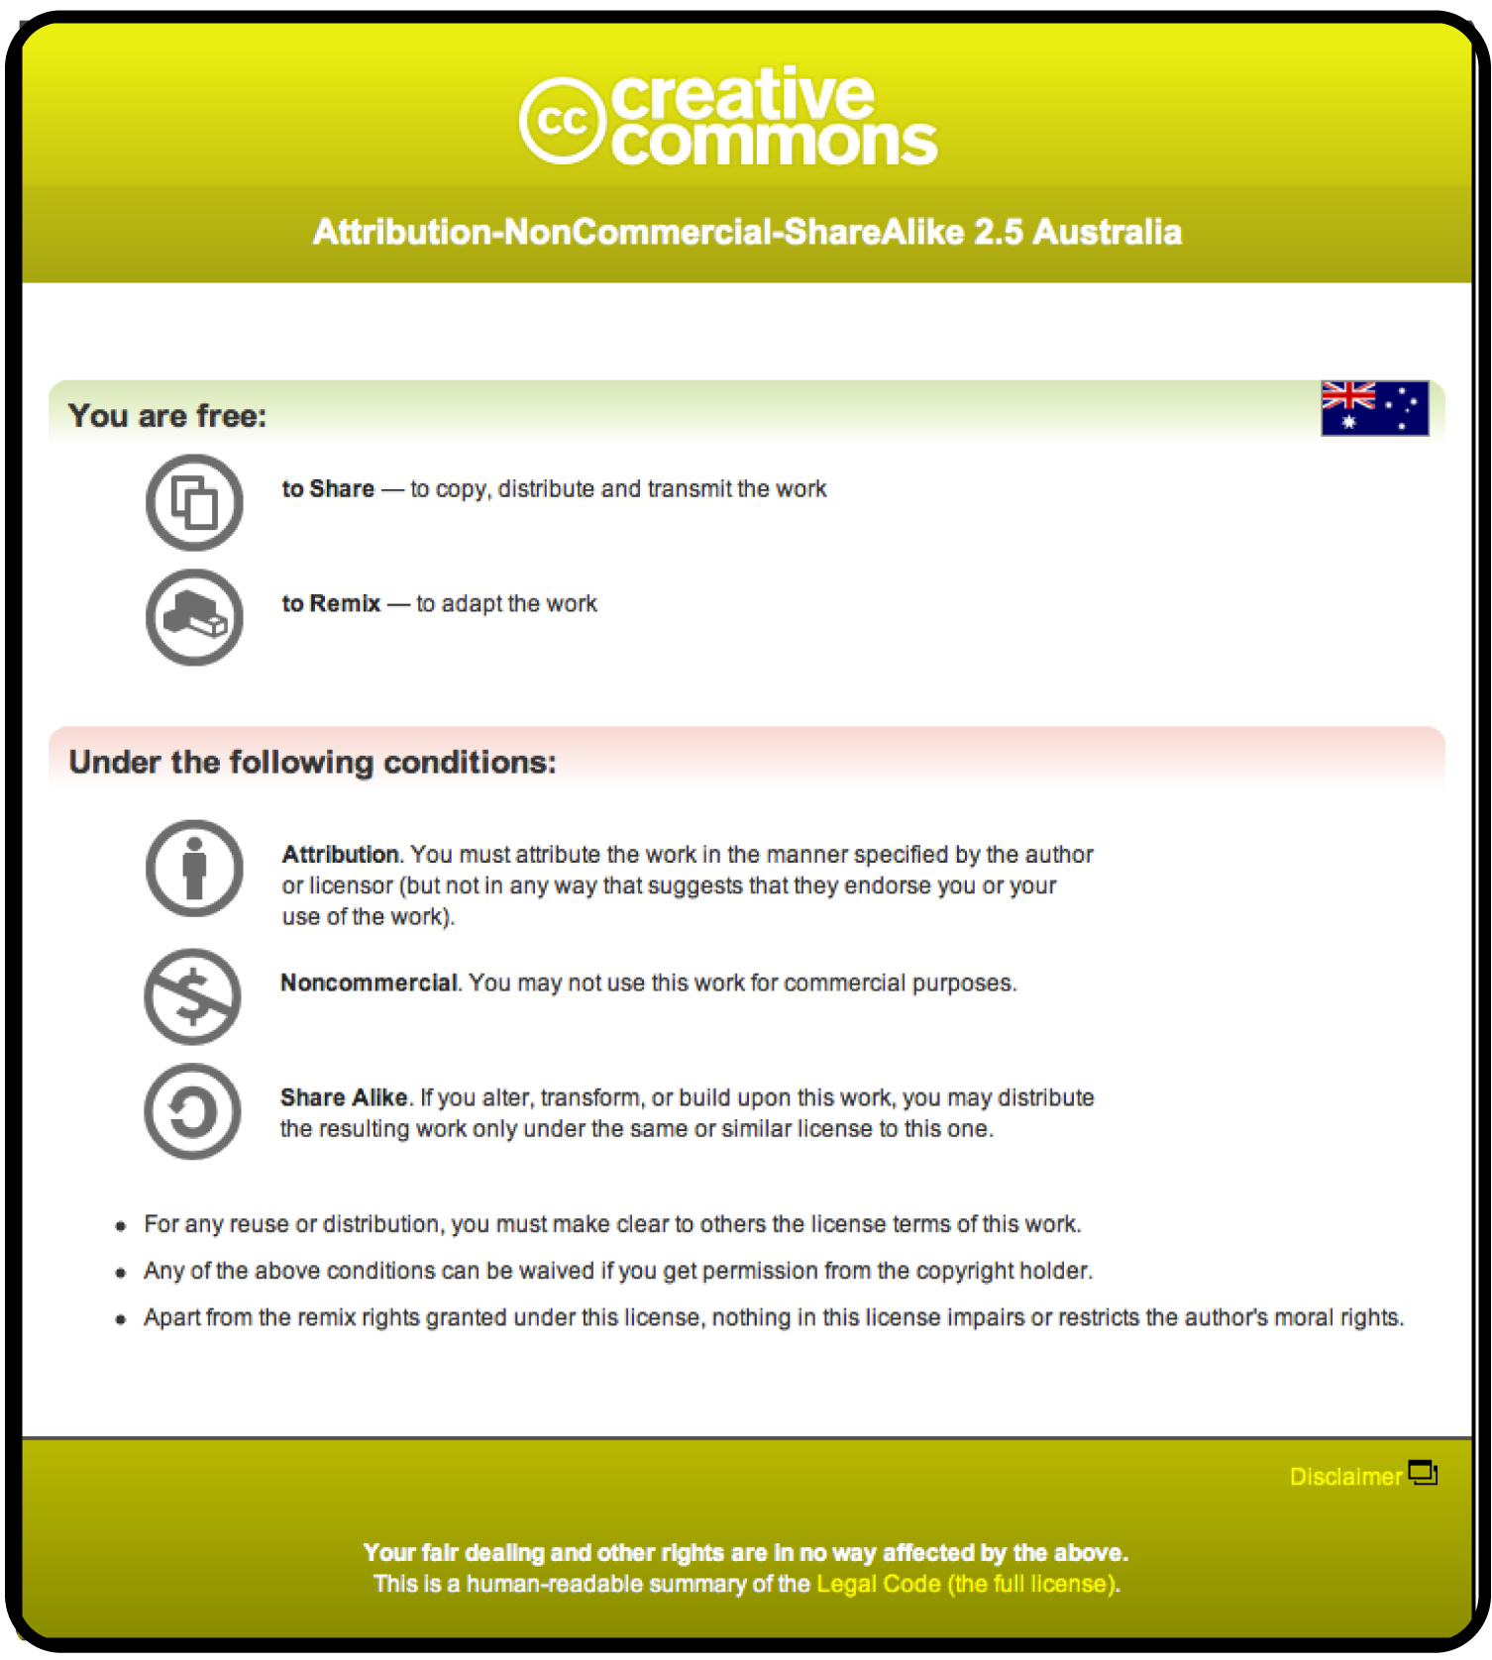
creative commons
Notes:
This will embed in your website the button that you decided on which will become a link to the Commons Deed a human readable summary of the licence.

Slide 17
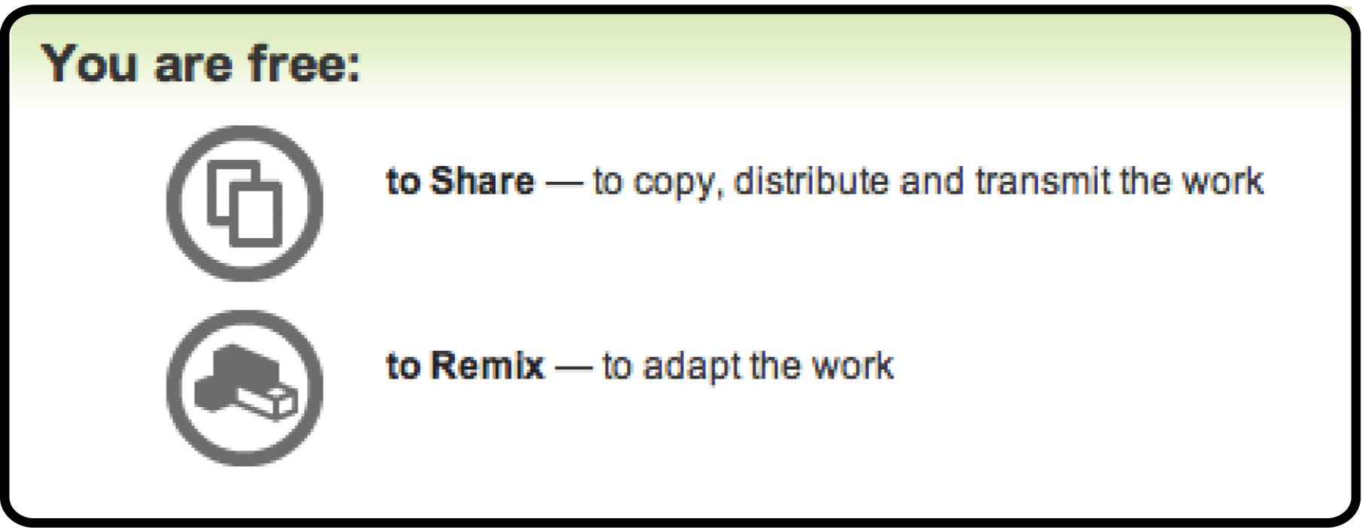
creative commons
Notes:
And the terms

Slide 18
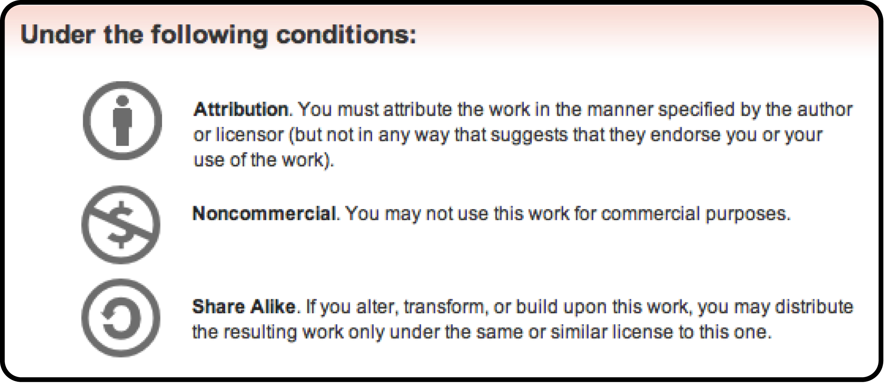
creative commons
Notes:
Which outlines the freedoms

Slide 19
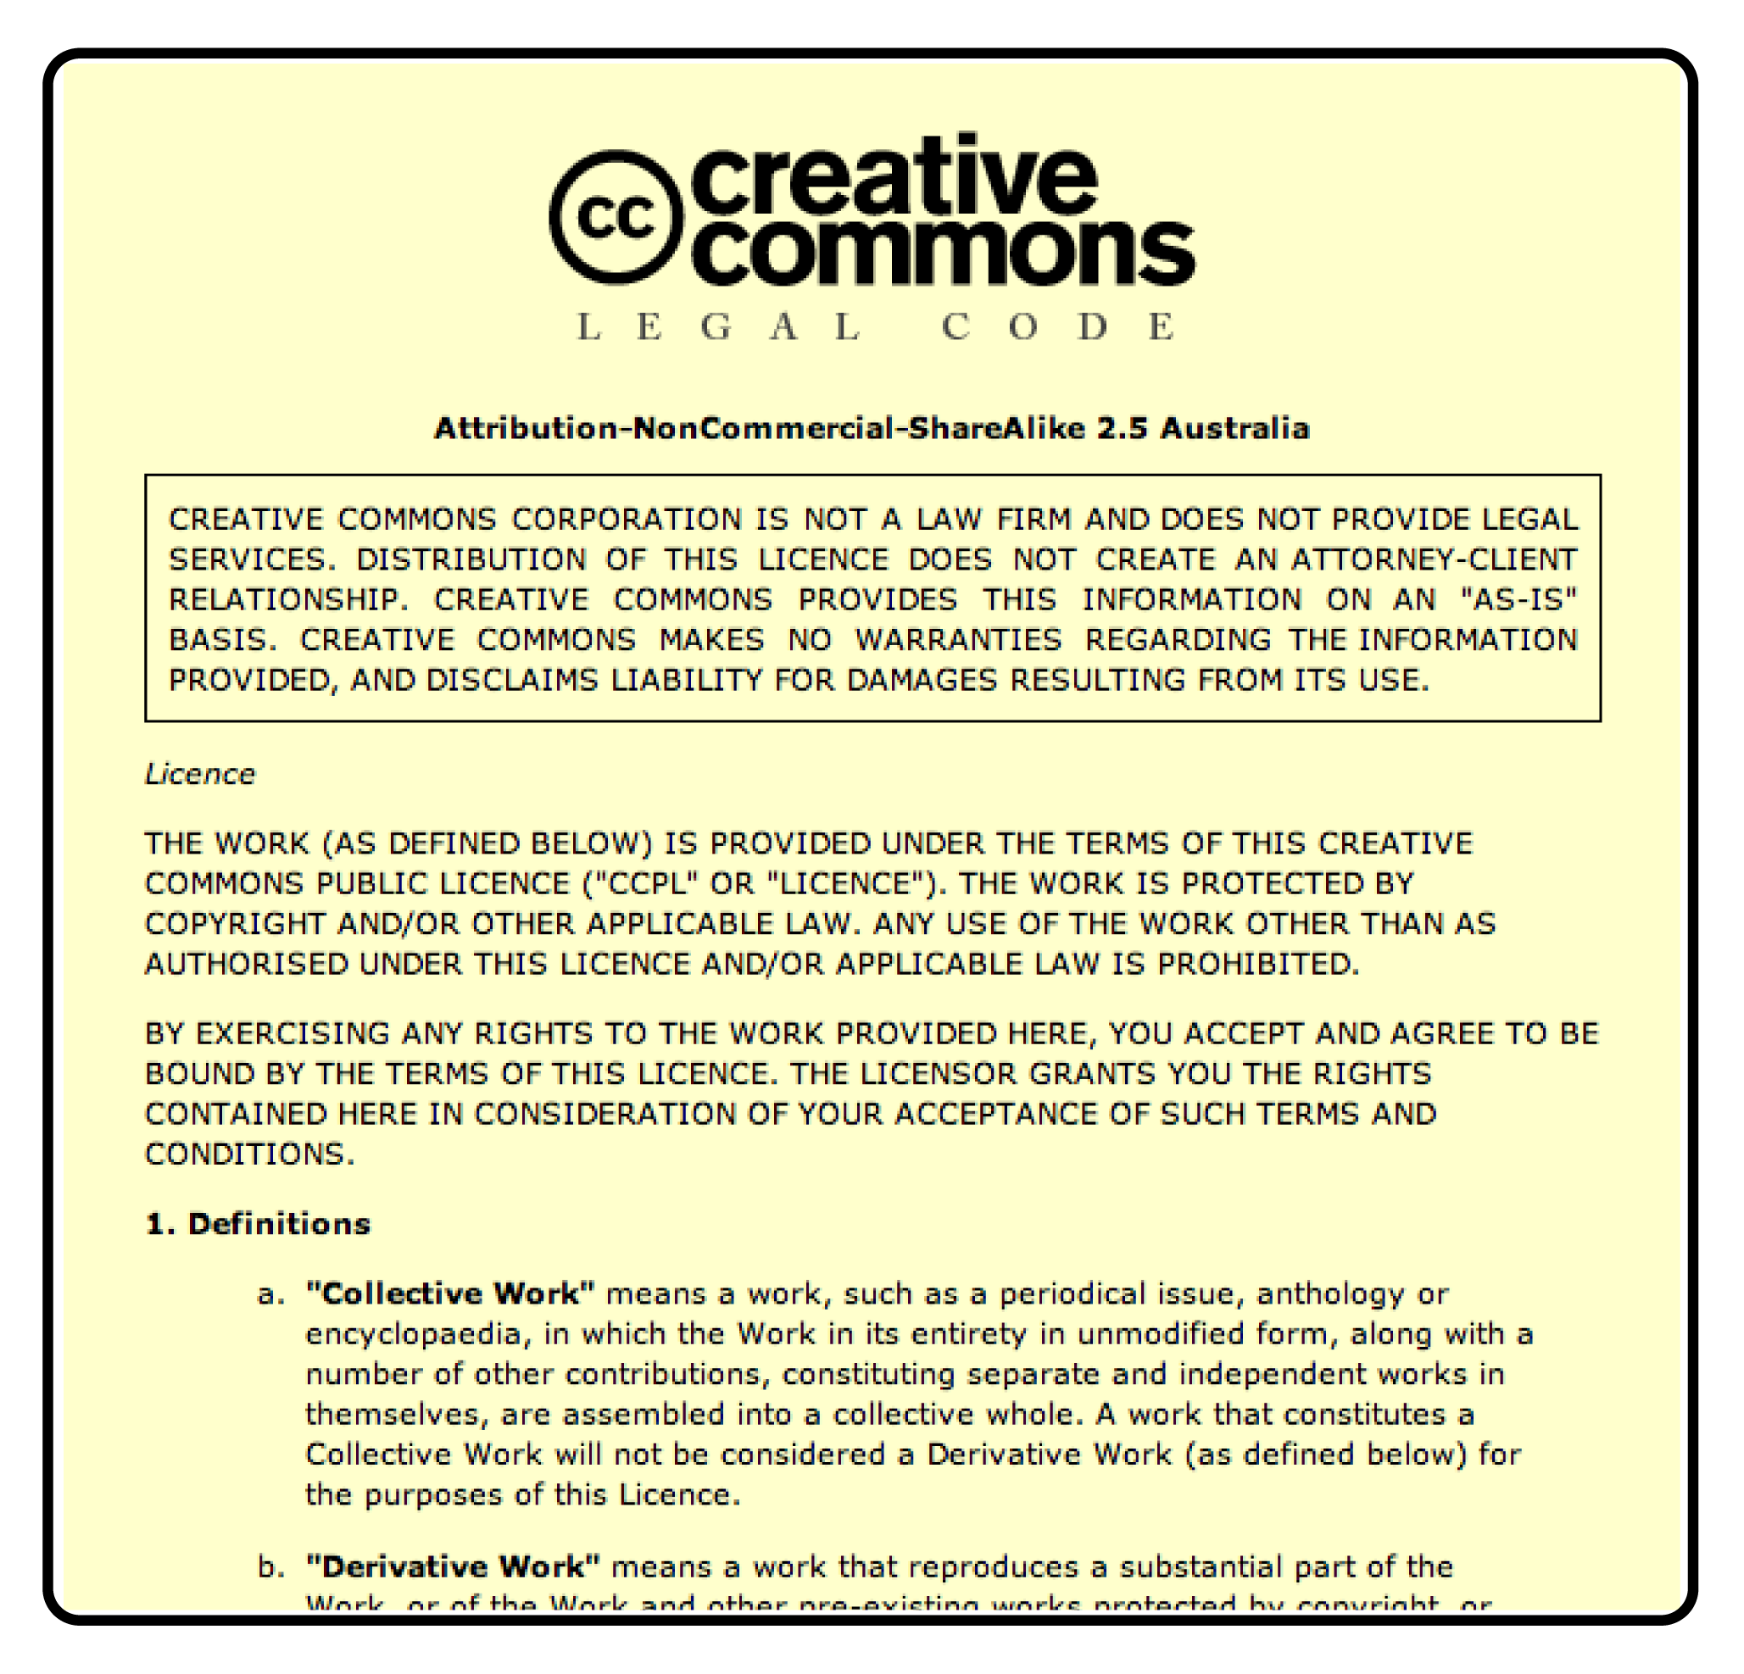
creative commons
Notes:
To back it up is a legal licence.

